Slide 1
Mining for Recommendation Systems
Case Study : Online Grocery Store

Slide 2
PATH WAY
01
02
03
04
INTRODUCTION
Recommendation Systems (Problem Identification & Definition)
DATA ANALYTICS
Dataset description, pre-processing, visualization
MODELLING and EVALUATION
Algorithm description, Model tuning & Evaluation
CONCLUSION
Summary, Limitations & Future scope

Slide 3
一STEVE JOBS
“A lot of times, people do not know what they want until you recommend it to them.”

Slide 4
01
INTRODUCTION
Recommendation Systems (Problem Identification & Definition)

Slide 5
PROBLEM STATEMENT…
Use of Recommendation Systems to improve the revenue of a business for variety of existing products as well as the latest products
“We are leaving the age of Information and entering the age of Recommendation”

Slide 6
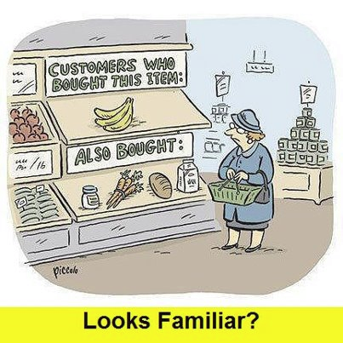
What are Recommendation Systems!
Recommendation Systems, also known as Recommendation engines, are a type of information systems whose purpose is to suggest or recommend items to the customers
We can say it as an automated form of a “Customer Service Associate”

Slide 7
Why use Recommendation Systems!
Do you know what recommendation helps you?
Because they’re simple
You can organize your ideas clearly
And because you’ll never forget to buy milk!
And the most important thing:
“They help in addressing the information overload problem by retrieving the information desired by the user based on their preferences and interests. They can influence their lifestyle”

Slide 8
How
Recommendation Systems are being used
Matches varying individual customers taste with huge inventory
Recommendations pertaining to specific program suggestions for redemption and upgrades
Loyalty Programs
Recommendations for new products up sell cross sell suggestions on product discovery
Order of search results on the store can be varied for each customer to aid product discovery
In E-Store
Product Discovery
Search

Slide 9
02
DATA ANALYTICS
Dataset description, Pre-processing, Visualization

Slide 10
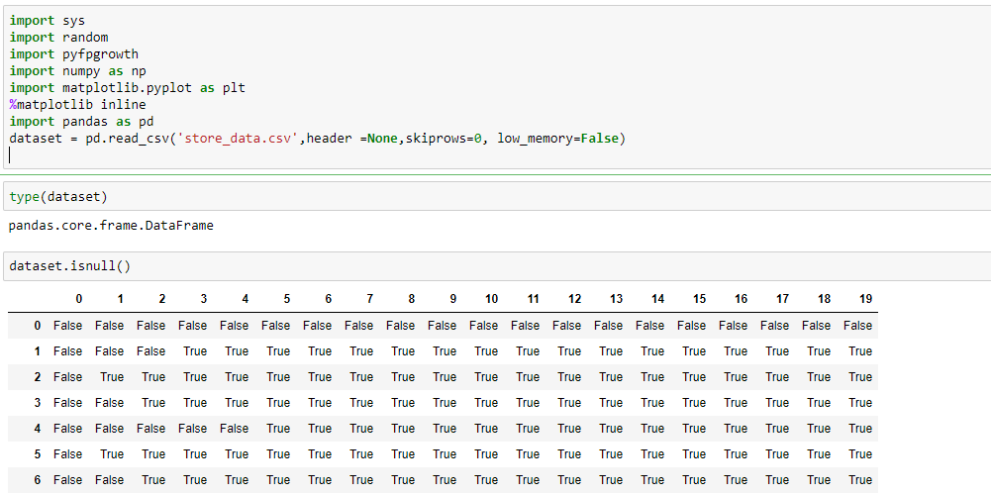
Dataset

Slide 11
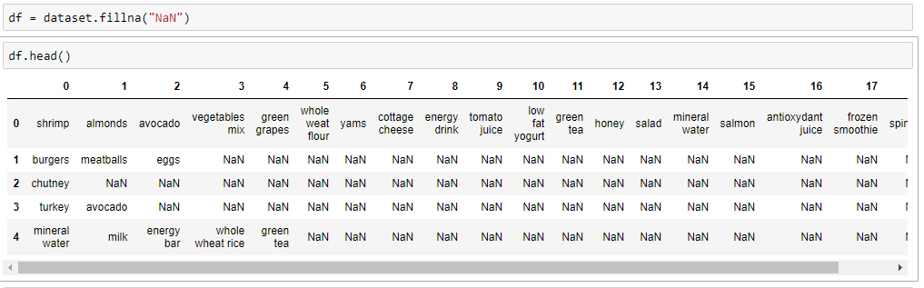
Dimensions: 7501 rows × 20 columns

Slide 12
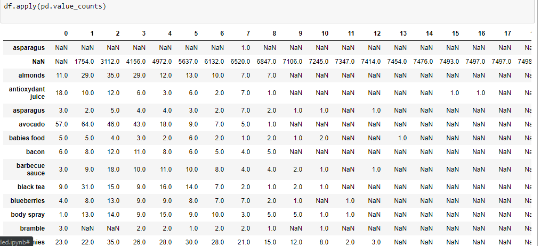
Value counts per column

Slide 13
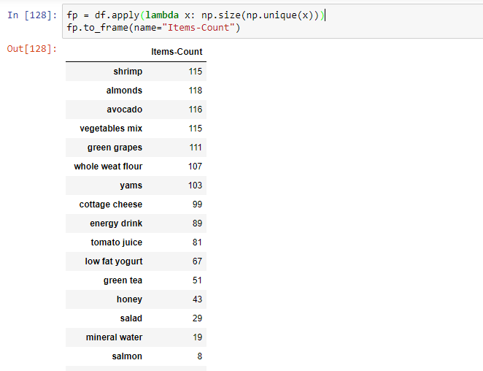
Unique Items

Slide 14
03
MODELLING and EVALUATION
Algorithm description, Model tuning & Evaluation

Slide 15
Market Basket Analysis
Market Basket Analysis is one of the key techniques used by the large retailers to uncover the association rules between items
Customer who purchase milk have a 60% of likelihood to buy bread
Association Rule Mining:
  Association rules can be thought of as an IF-THEN relationship
  A => B
  Association is measured using three parameters
    Support
    Confidence
    Lift

Slide 16
Apriori Algorithm
Apriori algorithm was the first algorithm that was proposed for frequent item set mining
It uses frequent item sets to generate association rules
It uses bottom up approach where frequent subsets are extended one item at a time ( a step known as candidate generation)
Apriori is designed to operate on database containing transactions
  Example : Collection of items bought by the customers

Slide 17
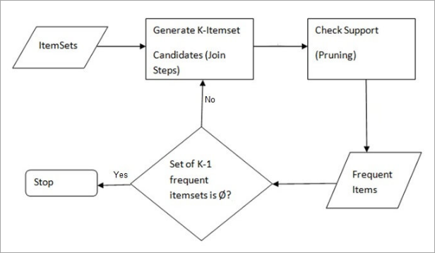
Apriori Algorithm

Slide 18
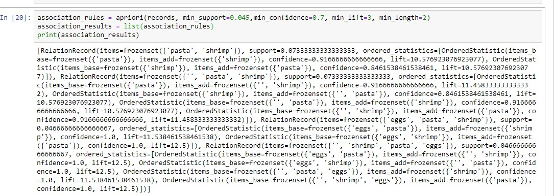


Apriori Algorithm
Some of them are :

Slide 19
Limitations of Apriori
The candidate generation could be extremely slow (pairs, triplets, etc.).
It requires high computation where item sets are very large and minimum support is kept very low on the implementation.
Calculating support is also expensive because it has to go through entire database multiple times.
Constant items make the algorithm a lot heavier.
Huge memory consumption

Slide 20
FP-Growth
FP Growth: It allows frequent item set discovery with candidate item set generation
The computation was arranged with the advantages of mapReduce considered, so it functions admirably with any appropriated framework concentrated on mapReduce
It adopts a divide and conquer strategy by compressing the database representing frequent items into a structure called FP-tree
Build a compact data structure called the FP-tree. In an FP-Tree each node represents an item and it's current count, and each branch represents a different association.
Generate strong association rules from the frequent item sets(Association rule mining)
  These rules must satisfy minimum support and minimum confidence

Slide 21
FP-Growth
  Step 1 : Consider a Transaction Data
Transaction ID | Item Sets
T1 | {M,O,N,K,E,Y}
T2 | {D,O,N,K,E,Y}
T3 | {M,A,K,E}
T4 | {M,U,C,K,Y}
T5 | {C,O,O,K,I,E}

Slide 22
FP-Growth
  Step 2 : List down the items and their frequencies
  Step 3 : Take the minimum support as say 3 which means
  the product has to be bought 3 times at least.
Item | Support Count
M | 3
O | 3
N | 2
K | 5
E | 4
Y | 3
D | 1
A | 1
U | 1
C | 1
I | 1
Items set (L) | Count >= Min Support
K | 5
E | 4
M | 3
O | 3
Y | 3

Slide 23
FP-Growth
  Step 4 : Generate the Ordered Item set with Conditional Pattern base
Txn ID | Item Sets | Ordered Item Set | Items | Conditional pattern base
T1 | {M,O,N,K,E,Y} | K,E,M,O,Y | Y | (K,E,M,O:1) (K,E,O:1) (K,M:1)
T2 | {D,O,N,K,E,Y} | K,E,O,Y | O | (K,E,M:1) (K,E:2)
T3 | {M,A,K,E} | K,E,M | M | (K,C:2) (K:1)
T4 | {M,U,C,K,Y} | K,M,Y | E | (K:4)
T5 | {C,O,O,K,I,E} | K,E,O | K

Slide 24
FP-Growth
  Step 5 : Build the FP Tree
NULL
Items | Count
K | 5
E | 4
M | 3
O | 3
Y | 3
K:5
E:4
M:2
M:2
O:1
O:2
Y:1
Y:1
Y:1

Slide 25
FP-Growth
  Step 6 : Extract the Frequent Pattern Generations
Items | Conditional pattern base | FP Tree | FP Generation
Y | (K,E,M,O:1) (K,E,O:1) (K,M:1) | { K : 3} | <K,Y : 3>
O | (K,E,M:1) (K,E:2) | {K,E : 3} | <K,O :3> < E,O :3> <K,E,O : 3>
M | (K,C:2) (K:1) | {K : 3} | <K,M : 3>
E | (K:4) | {K : 4} | <K,E : 4>
K | NA | NA | NA

Slide 26
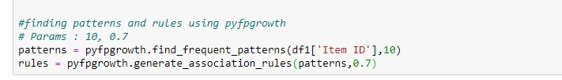
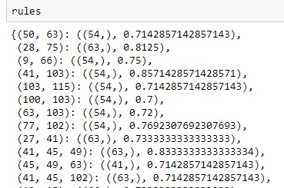
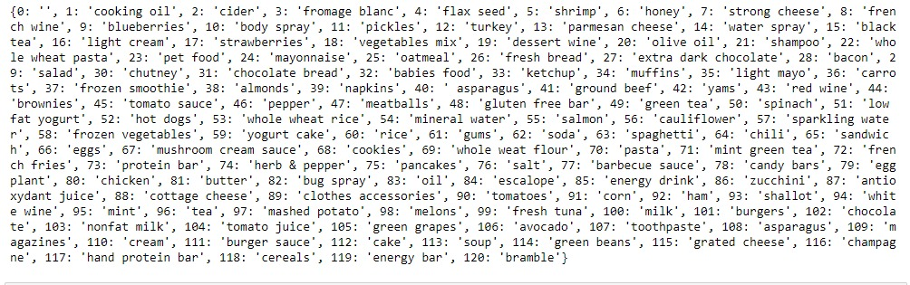
FP Growth

Slide 27
FP-Growth
FP-Growth Biggest Advantages
The biggest advantage found in FP-Growth is the fact that the algorithm only needs to read the file twice, as opposed to Apriori who reads it once for every iteration.
Another huge advantage is that it removes the need to calculate the pairs to be counted, which is very processing heavy, because it uses the FP-Tree. This makes it O(n) which is much faster than Apriori.
The FP-Growth algorithm stores in memory a compact version of the database.

Slide 28
COMPARISON OF TWO TECHNIQUES
Apriori
FP GROWTH
Use Apriori properties with Join and Prune
Save singletons, pairs, triplets etc., which takes more memory for large candidate sets
Number of Scans increase with increase in the item sets
Runtime increases exponentially depending on the number of different items.
Constructs conditional FP tree and conditional pattern base from DB which support minimum support
Stores compact version of Database with no candidate generation
Scans the item sets only twice
Runtime increases linearly, depending on the number of transactions and items

Slide 29
04
CONCLUSION
Summary, Limitations & Future scope

Slide 30
Conclusions:
FP growth better for recommendation system basis the performance as it scans the database only twice.
Although it is expensive in terms of computation cost, it is more accurate than Apriori.
It is more complex as it follows tree structure to produce rules. Data is very interdependent and each node requires a root.
It is more scalable because of its linear runtime. The runtime increases depending upon a number of transactions and items.

Slide 31
Future Work
One can use collaborative filtering with FP growth for a hybrid recommendation system as, FP growth doesn't fit well on large database.
Assembly methods can be used.
Feature combination to enhance the predictability of algorithms.
We can apply graph-based methods on the heterogeneous dataset.

Slide 32
REFERENCES:
“Apriori vs FP-Growth for Frequent Item Set Mining.” Singular Me Corp., 2019, www.singularities.com/blog/our-blog-1/post/apriori-vs-fp-growth-for-frequent-item-set-mining-11. Accessed 2 Dec. 2019.
Keshari, K. (2019). Apriori Algorithm : Know How to Find Frequent Itemsets | Edureka. [online] Edureka. Available at: https://www.edureka.co/blog/apriori-algorithm/ [Accessed 2 Dec. 2019].
“Build Software Better, Together.” GitHub, May 2019, github.com/search?q=recommender+system+using+fp+growth&type=Repositories. Accessed 2 Dec. 2019.
Kavitha, Mrs, and S T Tamil Selvi. “Comparative Study on Apriori Algorithm and Fp Growth Algorithm with Pros and Cons.” International Journal of Computer Science Trends and Technology (IJCS T), vol. 4, 2016, pdfs.semanticscholar.org/3bc3/6381f77ec371b0931d3276a3f4f58d186427.pdf. Accessed 2 Dec. 2019.
Pavel Kordík. “Machine Learning for Recommender Systems — Part 1 (Algorithms, Evaluation and Cold Start).” Medium, Recombee blog, 3 June 2018, medium.com/recombee-blog/machine-learning-for-recommender-systems-part-1-algorithms-evaluation-and-cold-start-6f696683d0ed. Accessed 29 Mar. 2019.

Slide 33
MEET THE TEAM!!!!!
Bharath Battula
Prahasith Kondra
Ruvita Sharma
Krishna Chaithanya
Venkat Sai Krishna

Slide 34
THANKS!
Any questions? Observations? Thoughts?

